Slide 1

DATA ANALYTICS Project

Slide 2

What did we Scrape and from where??
We Scrapped Houses details listed for sale around Bay Area on ZILLOW Website.
We scrapped the data using Beautiful Soup python library.

Slide 3
What are the steps for Analyzing Housing Data??
DATA CLEANING
DATA ANALYSIS
1
2
3
4
5
DATA VISUALIZATION
WEB SCRAPPING
DATA MANIPULATION

Slide 4
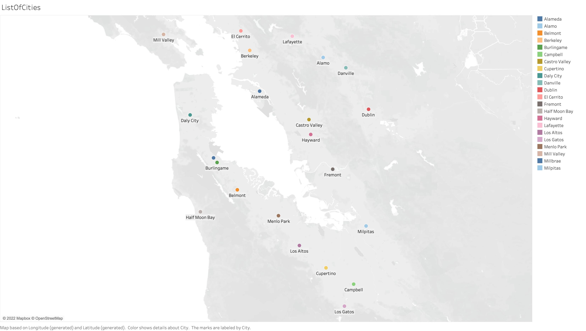
Cities we Scrapped house data from (Tableau Visuals)

Slide 5
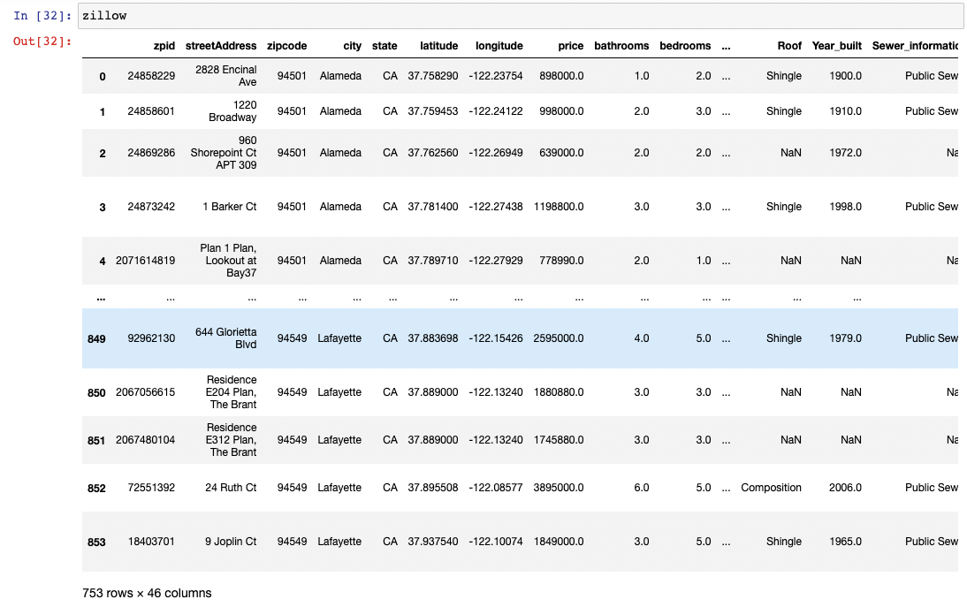
Scrapped data

Slide 6
Data Preparation Process
Dropping Irrelevant data/Null values
Replacing Missing Values by Imputation method
Removing Duplicates
Finding outliers
Categorical data
Feature Engineering/Selecting needed columns
Validation split for training

Slide 7
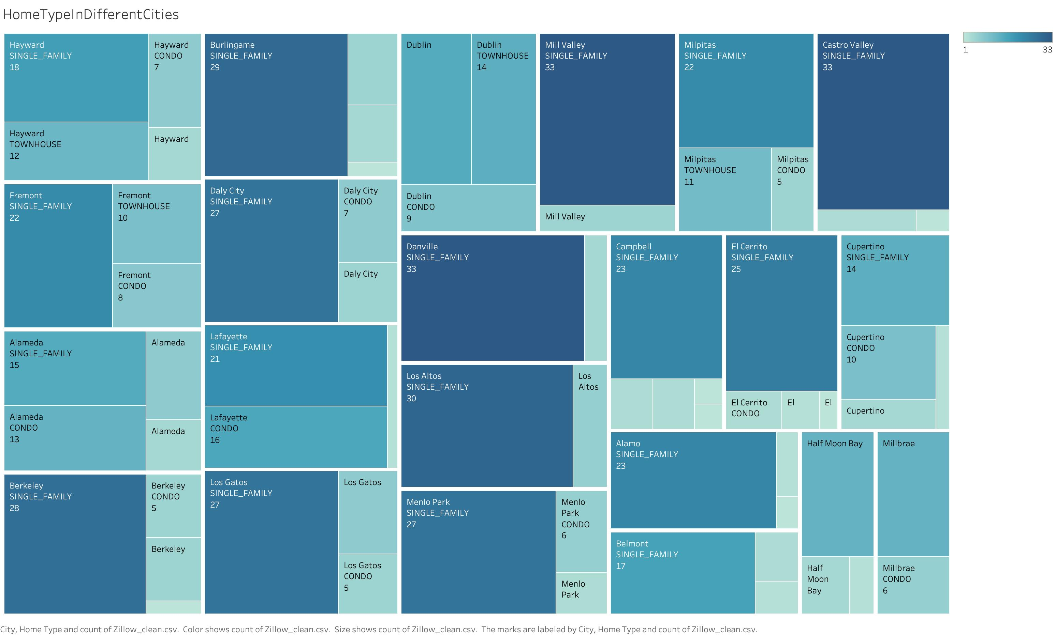
Visualizing count of different home_types in various cities (Tableau Visuals)

Slide 8
ANALYSIS Performed on data
Lowest crime rate per city
Highest school rating per city
Employment rate in each city
Percentage of properties from each city.
We took 40 houses from each city and performed data cleaning.
Visualizations are as follows

Slide 9
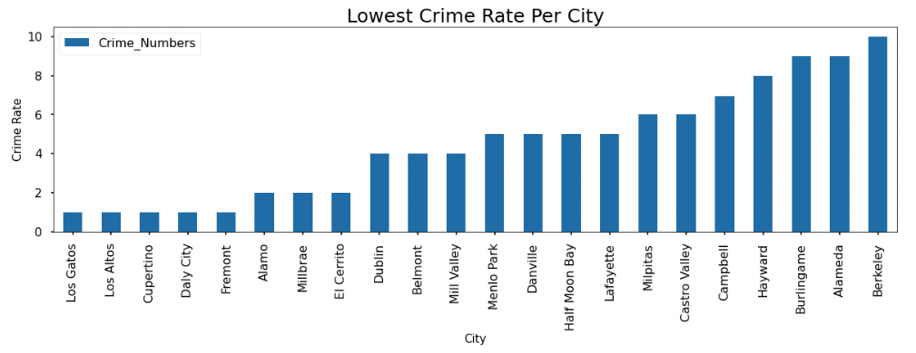
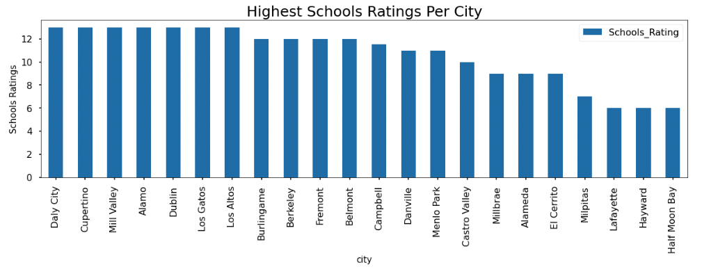
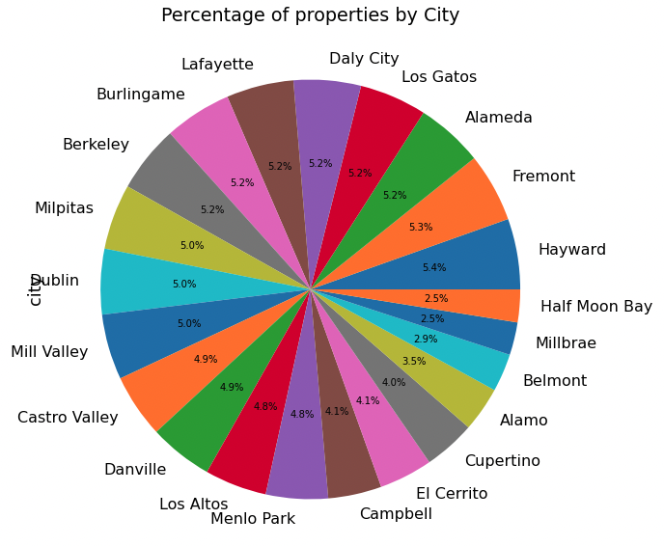
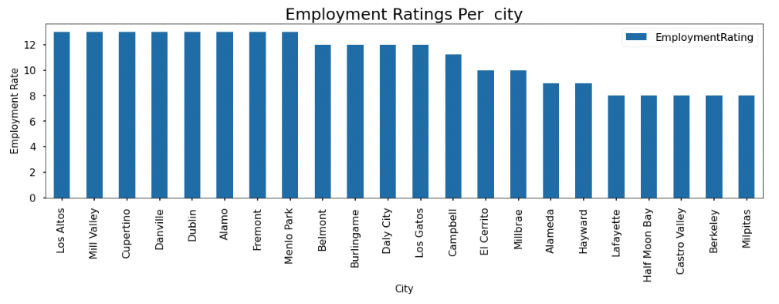
Data Analysis

Slide 10
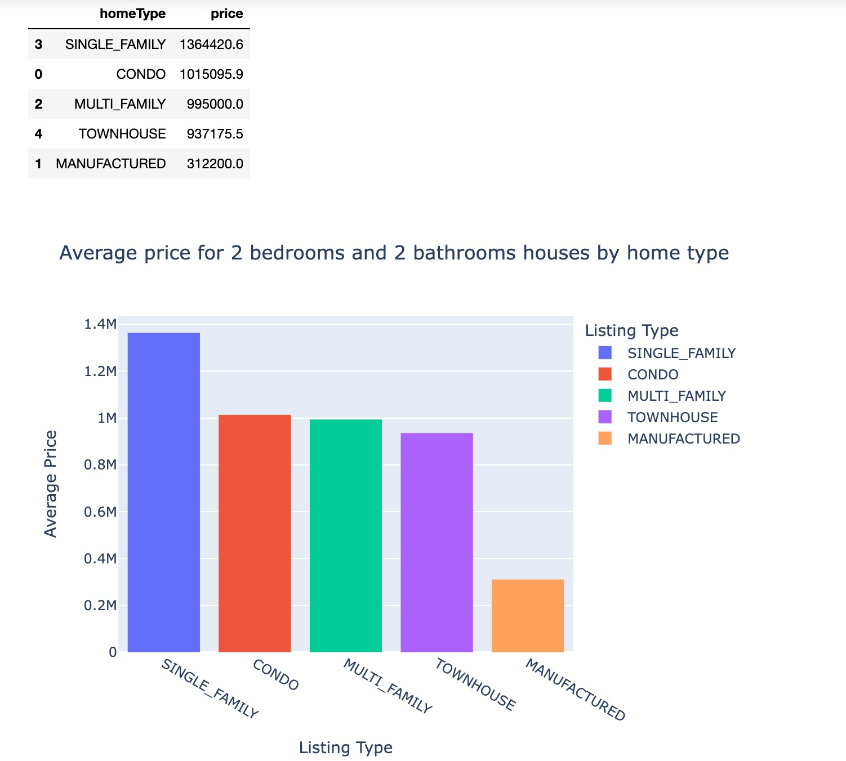
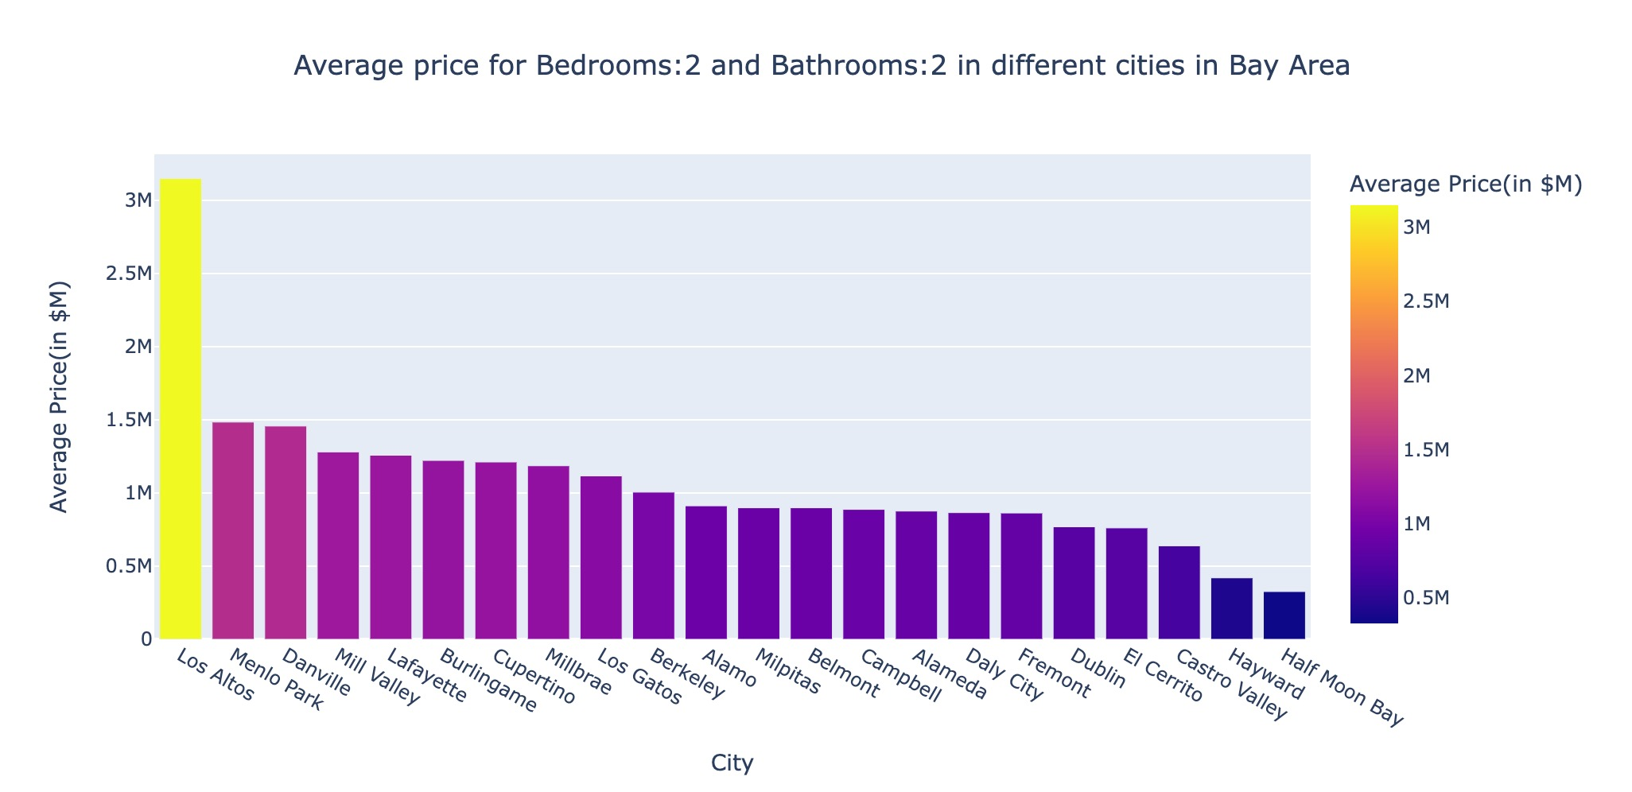
Average 2b2b prices for different house types & cities in Bay area

Slide 11
Research Questions
Price range for different types of properties.
How much space do we get for the lowest price, how much for the higher price and sqft at highest price and sqft at lowest price available.
Impact of Crime Rates, School rating and employment opportunities on housing prices in Bay Area?
Visualizations are as follows

Slide 12
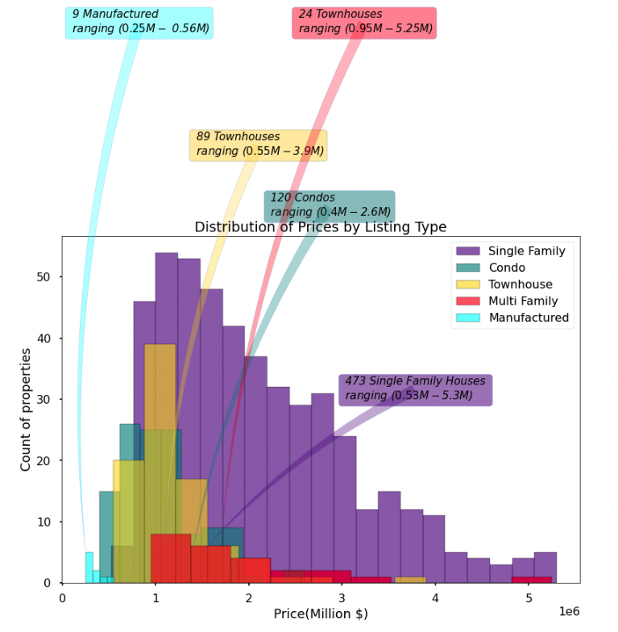
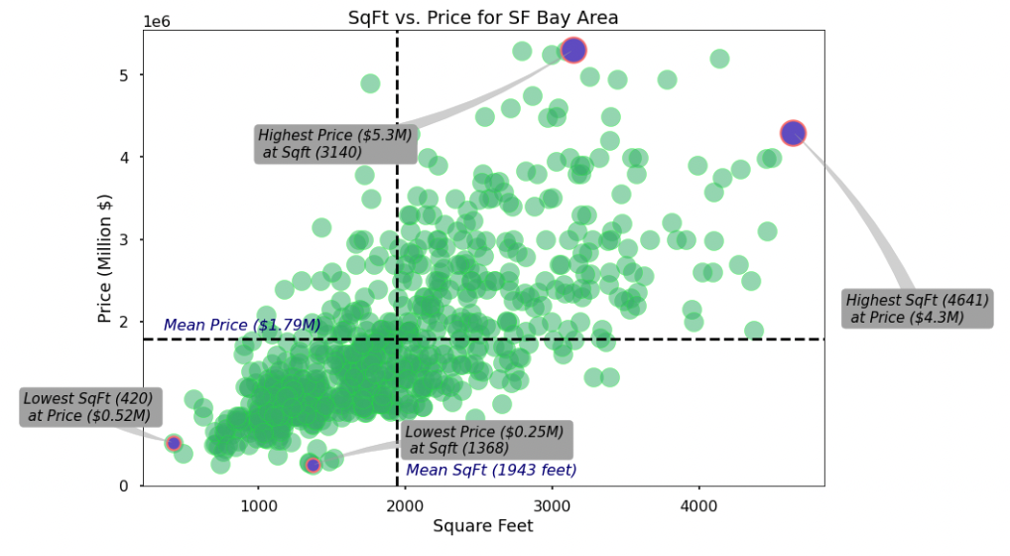
Research Questions

Slide 13
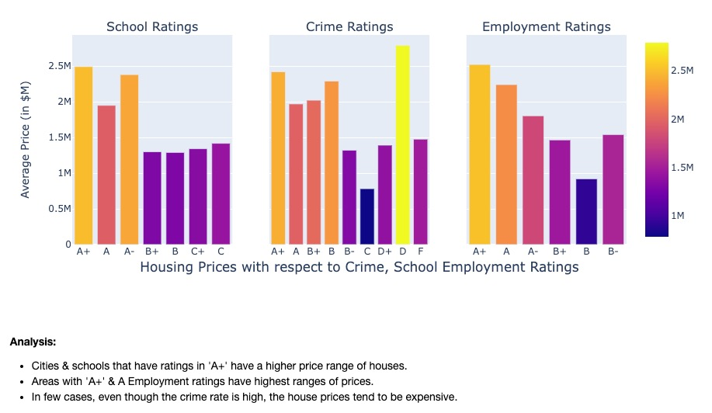

Slide 14
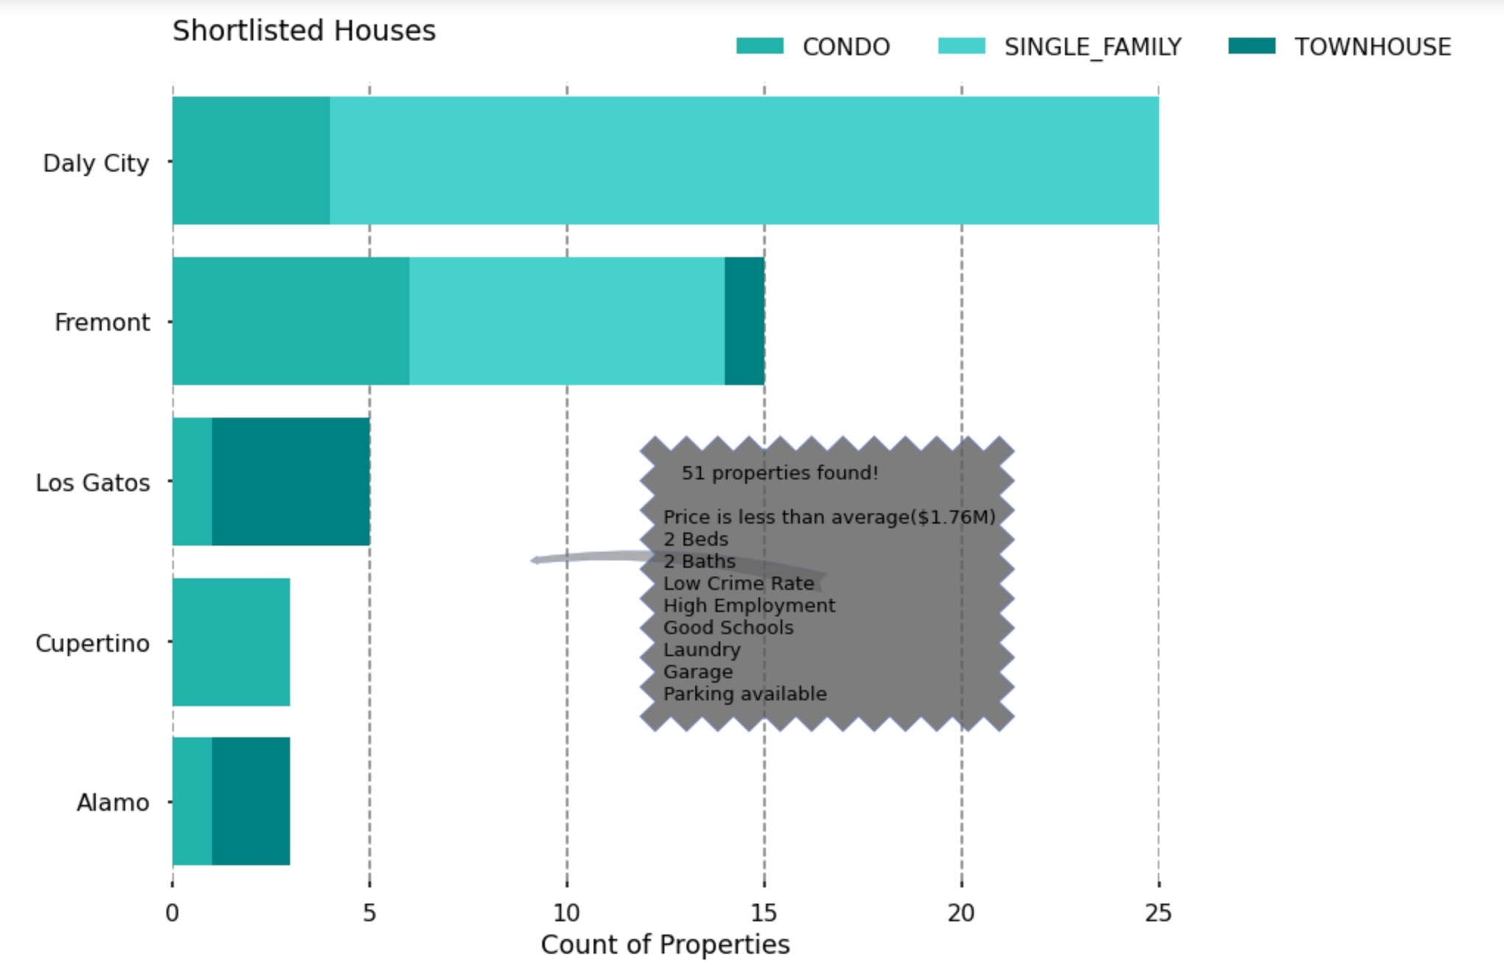
Requirement analysis
Finding count of different home_types, Properties in different cities with :
Low Crime rate
High employment rate
Good schools
Various amenities, etc..
With customer’s minimum requirements of:
2b2b
Parking/Garage facility
Laundry

Slide 15
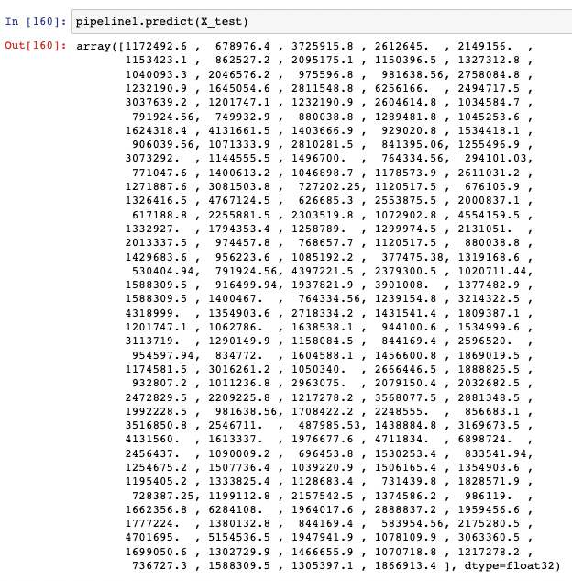
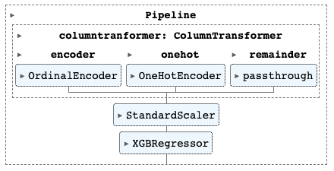
Build model
We built a regression model to predict the prices of the houses and compared the predicted value with the ZESTIMATE value.

Slide 16
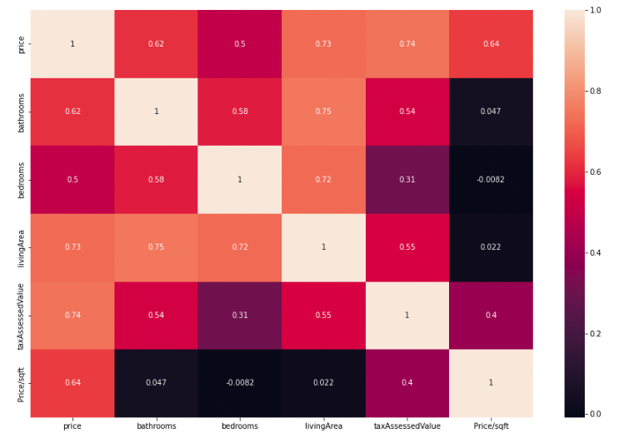
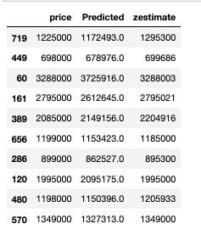
Price prediction comparison & heat map for regression dataset

Slide 17
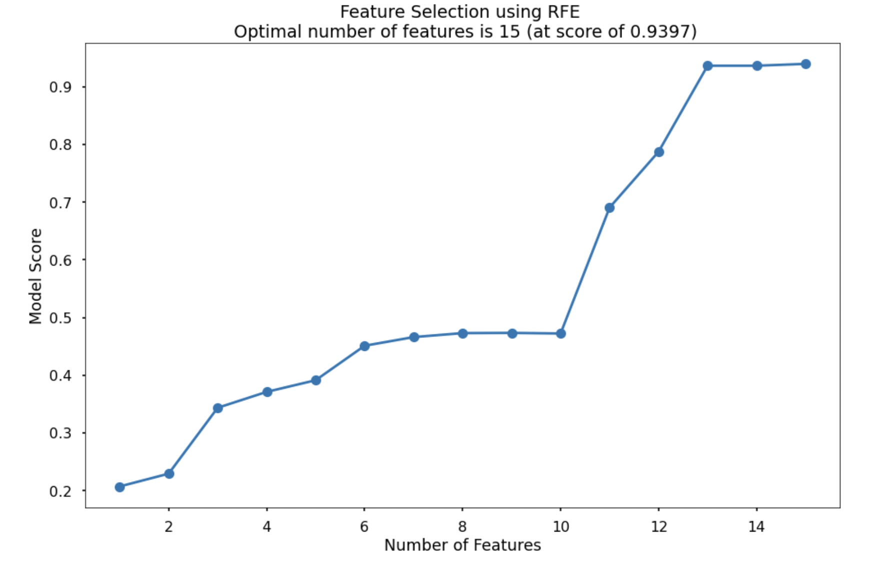
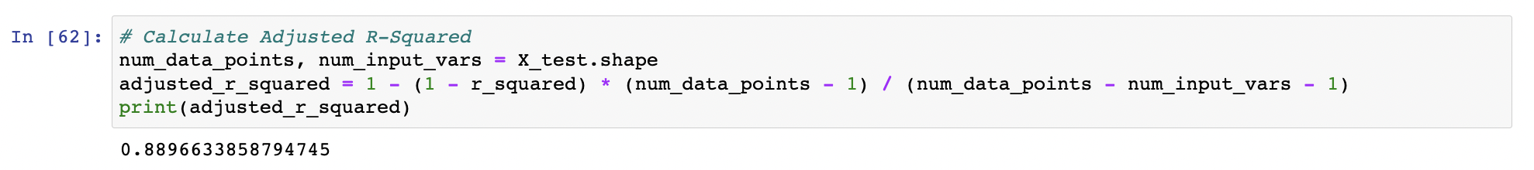

Slide 18
THANK YOU!

